Slide 1



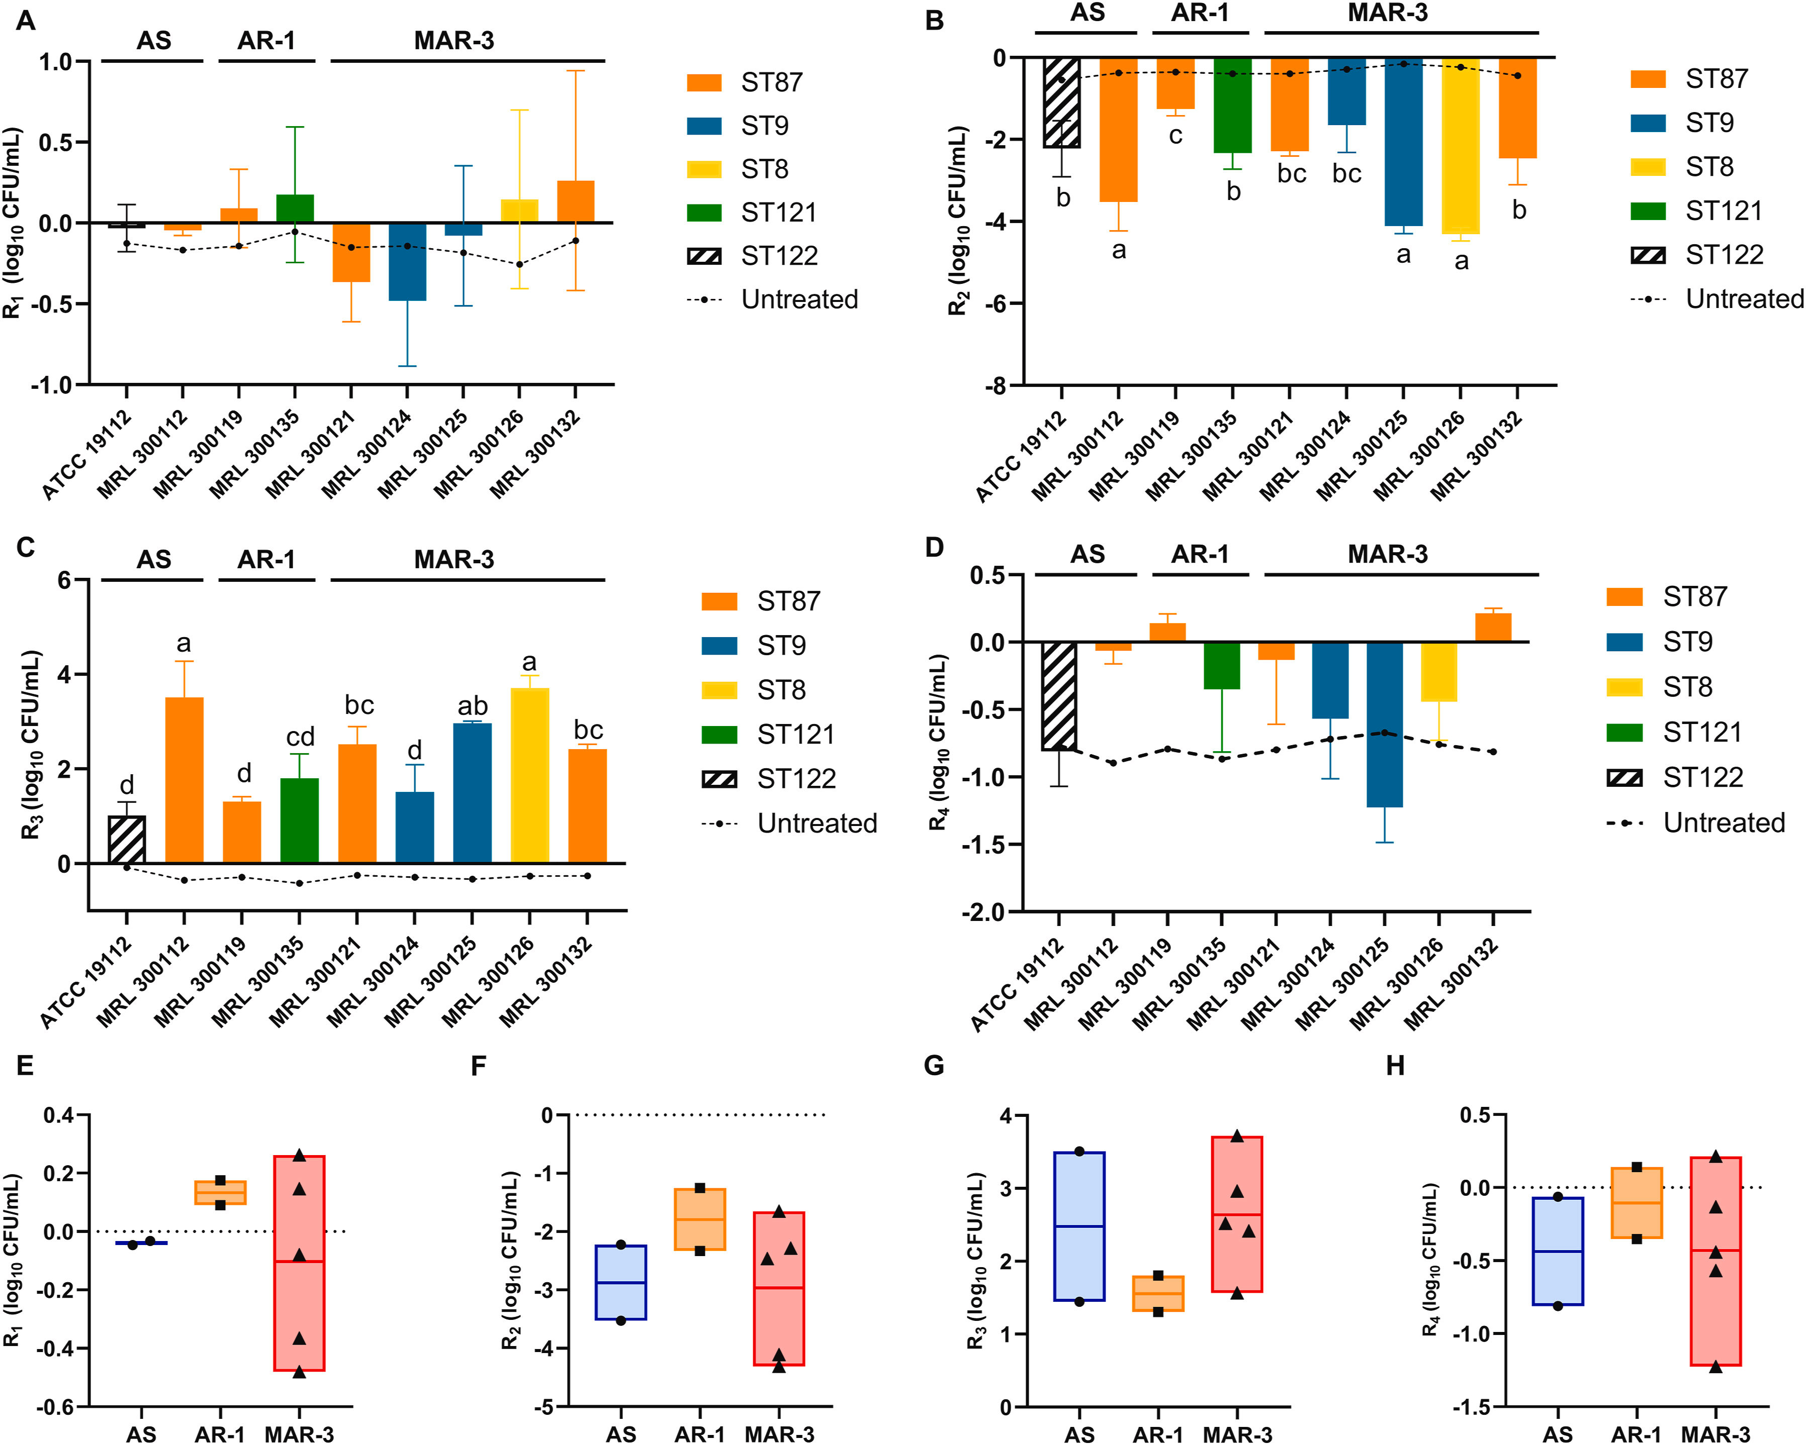
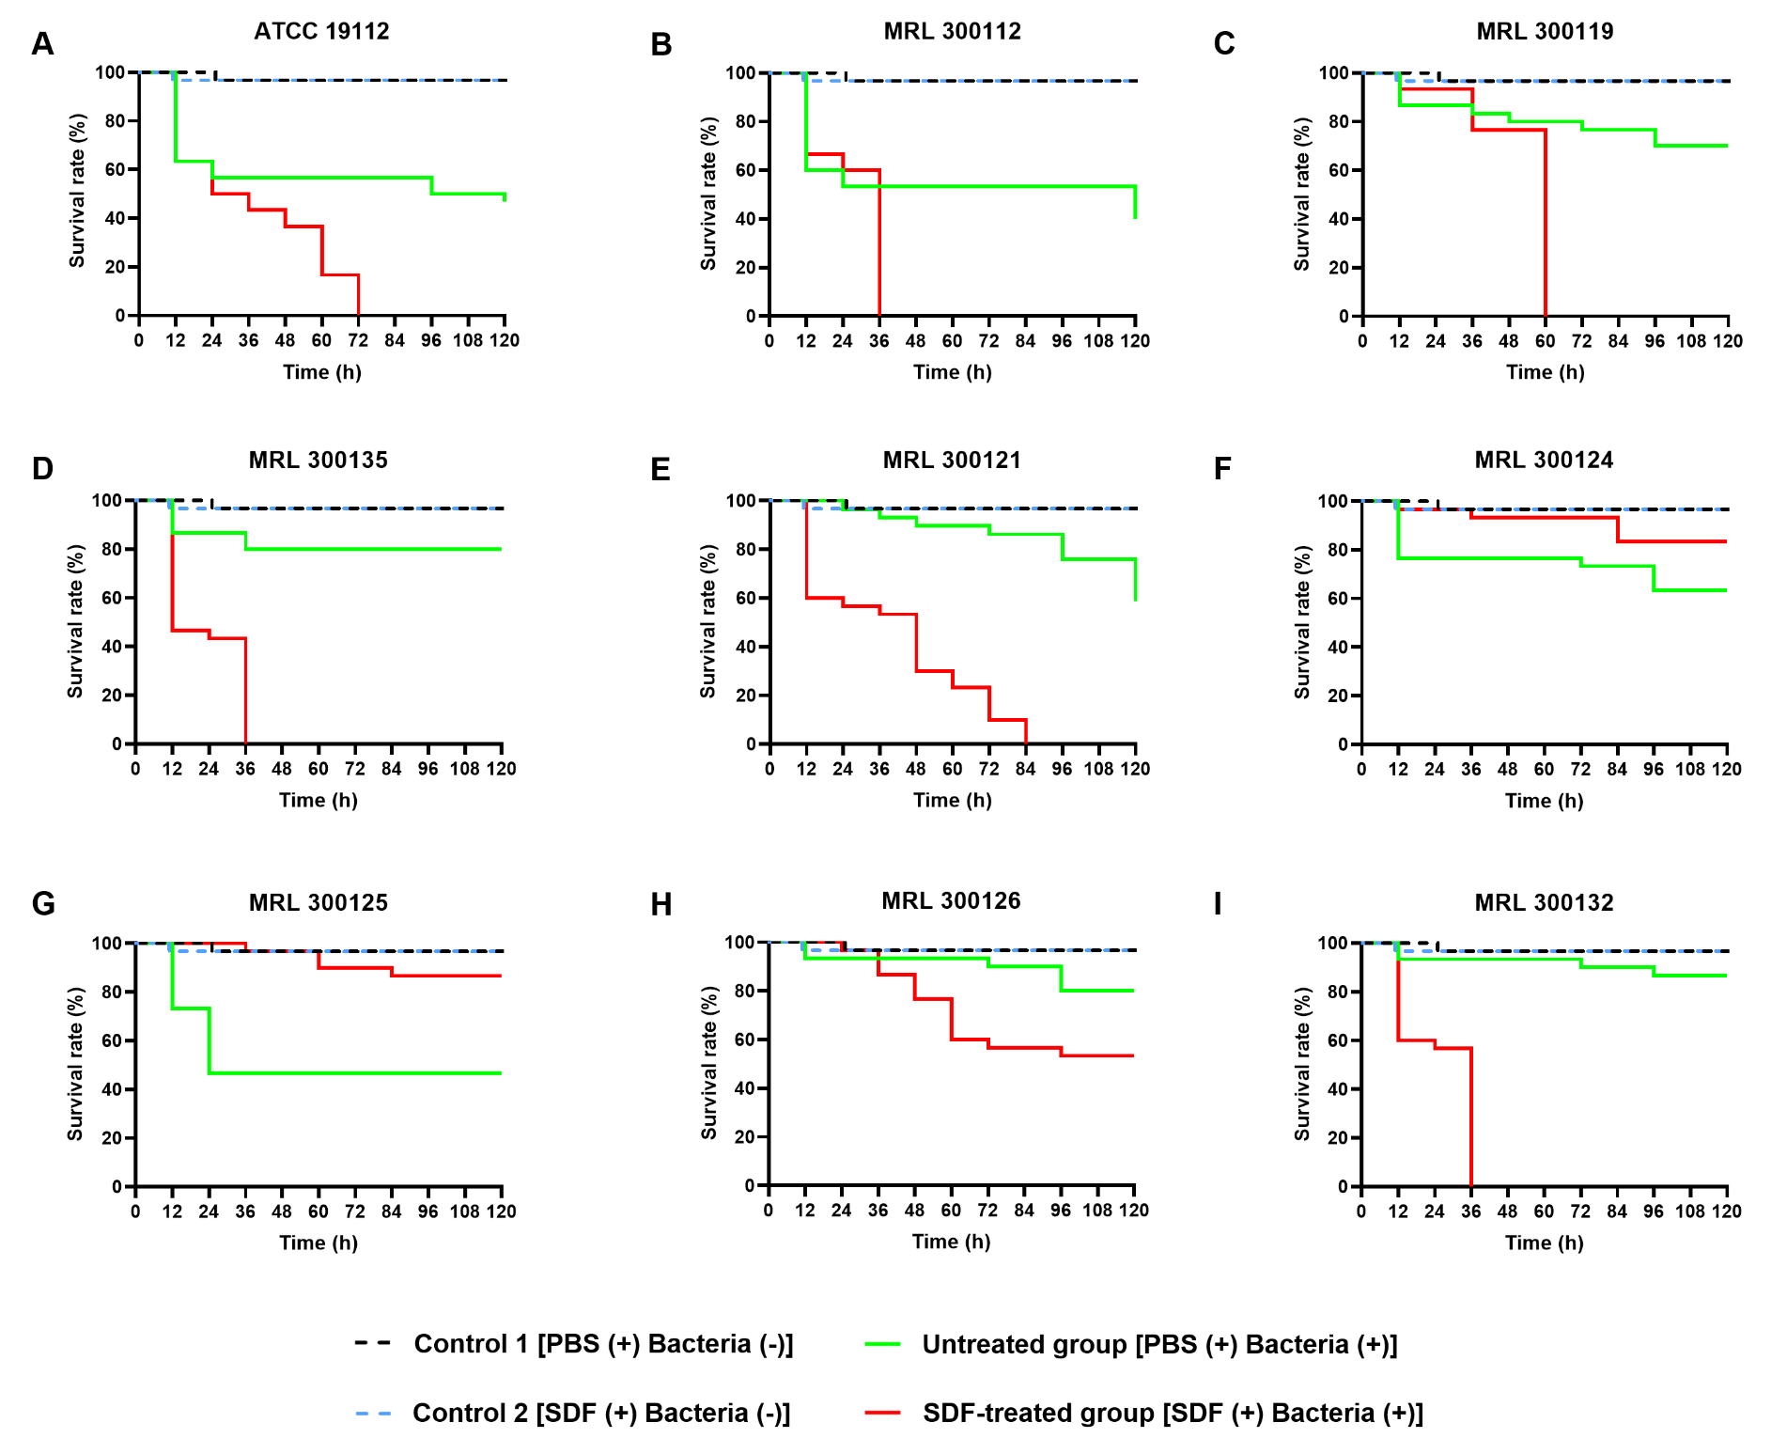
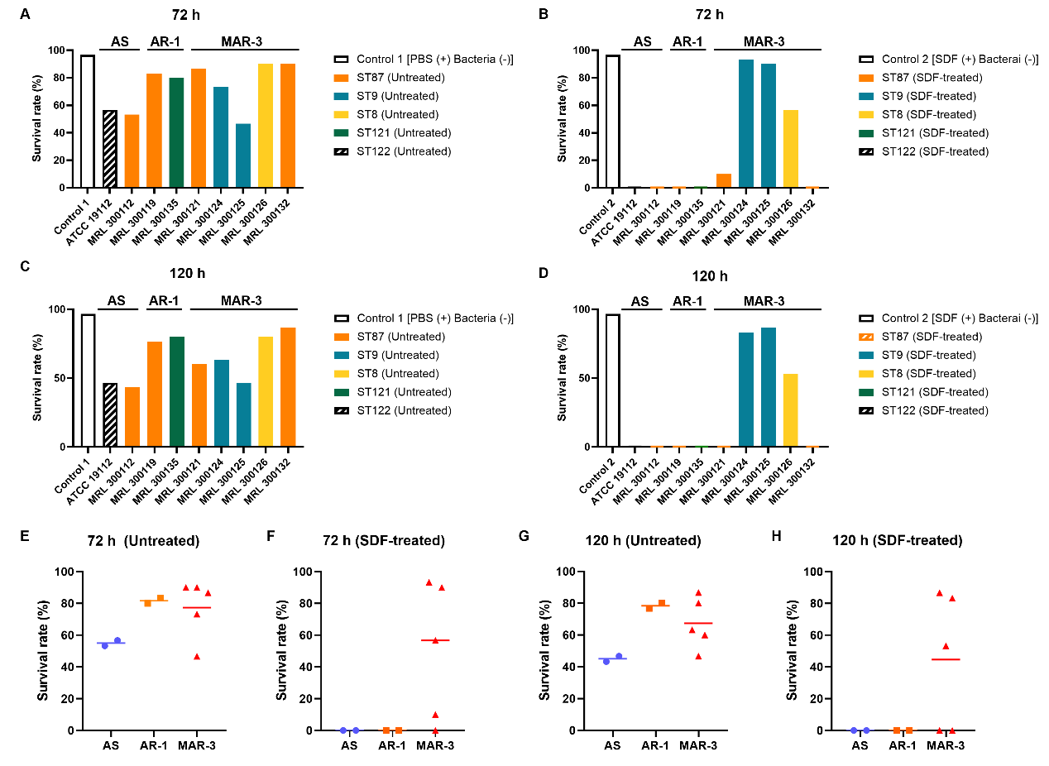
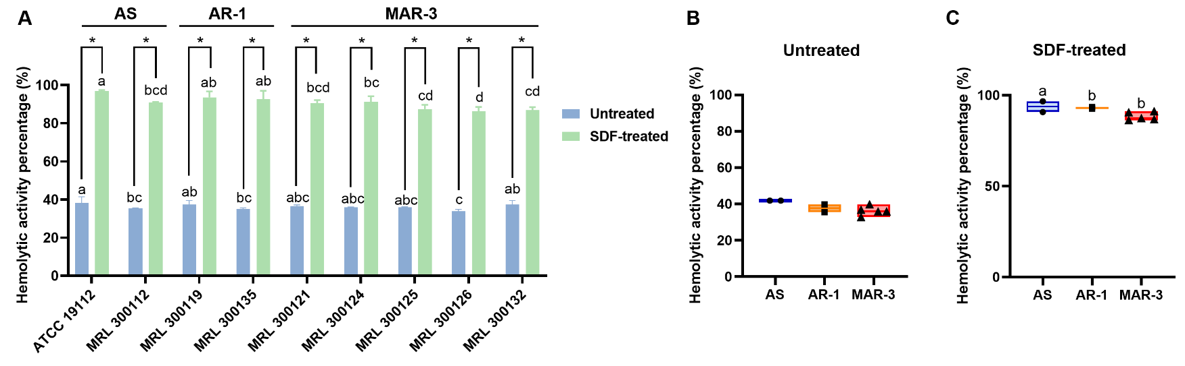
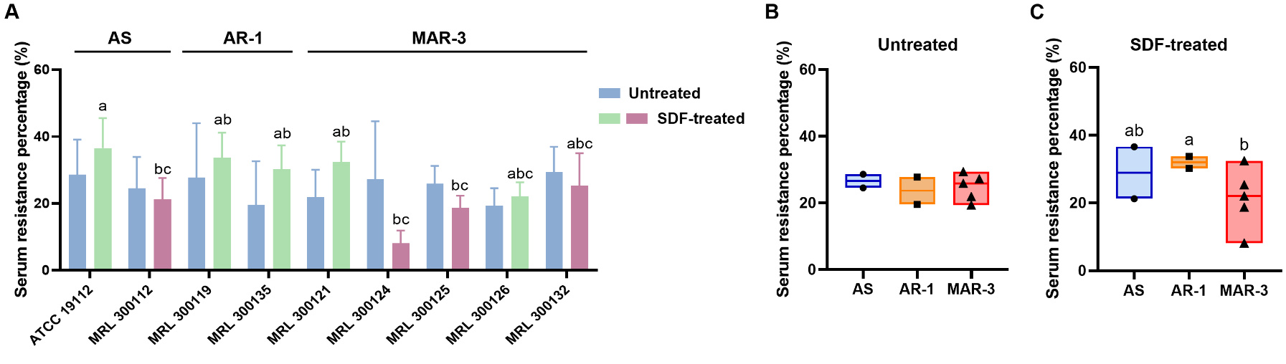
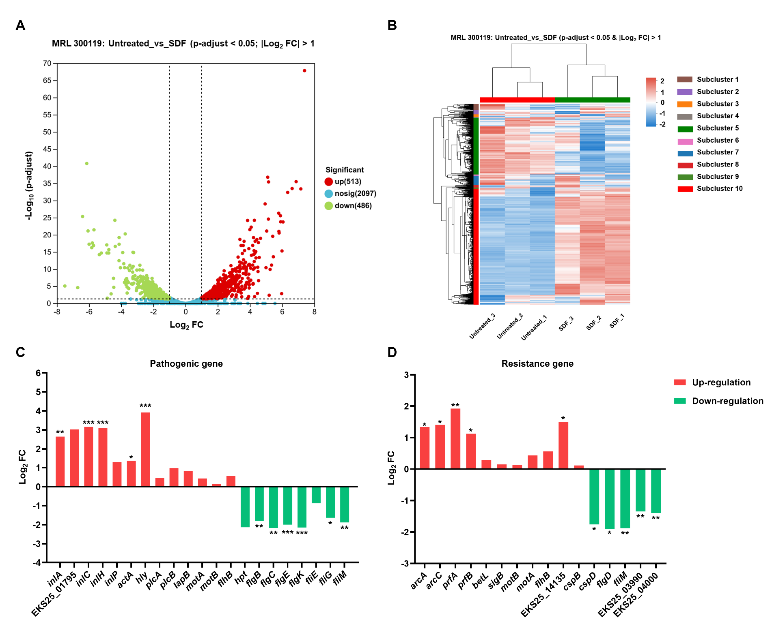
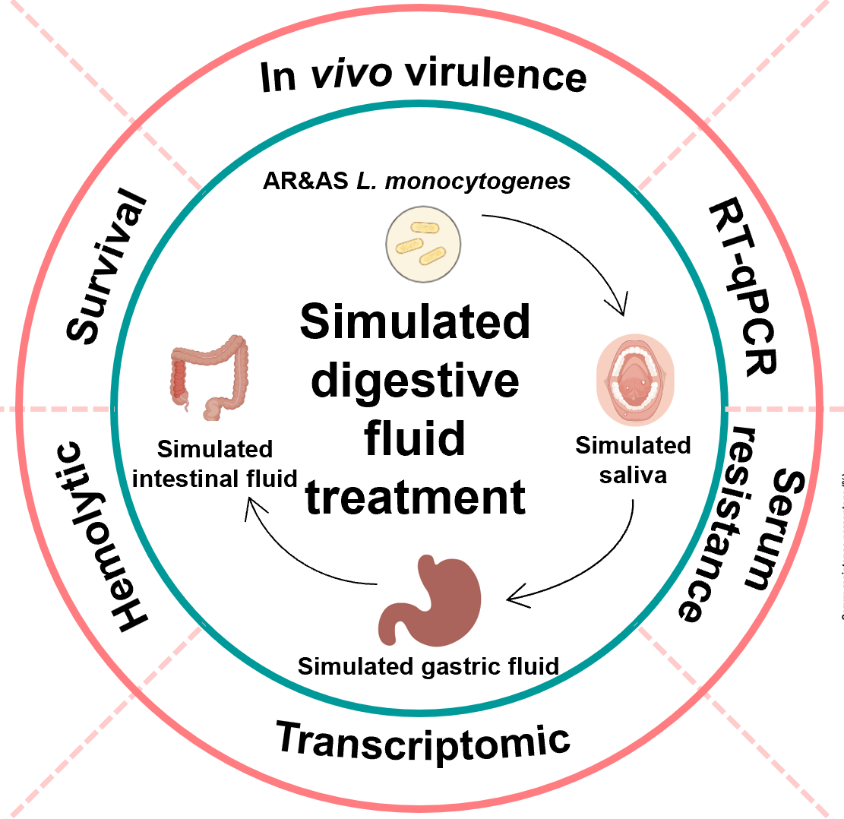
Survival and virulence changes in antibiotic-resistant and sensitive Listeria monocytogenes after consecutive gastrointestinal exposure
FSMILE 2025
October 04-07, 2025
@Morioka & ZOOM Cloud
B. Gao¹, M. Wu¹, B. Xu², L. Li³, H. Yan¹, Y. Xu¹, X. Xia¹, Q. Dong¹, T. Hirata^{4, 5}, Z. Li¹
1 School of Health Science and Engineering, University of Shanghai for Science and Technology, Shanghai, China
2 Shanghai Municipal Center for Disease Control and Prevention, Shanghai, China
3 Department of Urinary Surgery, Hohhot First Hospital, Hohhot, China
4 Kyoto University, Kyoto, Japan
5 Shijonawate Gakuen University, Osaka, Japan
International Symposium on Food Communications and Sustainable Agri-Aqua Food Systems
Connecting Primary Industries, Academia, and Society through the SDGs
Contact Information:
Zhuosi Li: lizhuosi@usst.edu.cn.
Introduction
Listeria monocytogenes is a foodborne pathogen of significant public health importance (Li et al., 2021). In recent years, L. monocytogenes has been reported to exhibit resistance to one or more antibiotics (Shourav et al., 2020). After being ingested via contaminated food, L. monocytogenes undergoes a complex process that involves exposure to saliva, gastric and intestinal fluids, crossing the gut barrier of host, spreading to various organs and tissues in the body (Cheng et al., 2023).
Results
AIM
Analyse effect of consecutive stimulation with digestive fluids on survival ability, hemolytic activity, serum resistance, and potential virulence of the selected antibiotic sensitivity (AS) and antibiotic resistance (AR) L. monocytogenes isolates.
Explore the effect of consecutive stimulation with digestive fluids on the gene expression changes related to the virulence of these strains through transcriptomic analysis.
Fig. 2. Survival curves of G. mellonella larvae infected with 9 L. monocytogenes strains with or without consecutive SDF treatment (A–I). Schematic diagram of larval precursor injected with bacterial suspension and photographs of larval morphological changes during infection (J).
Fig. 3. The survival rates of G. mellonella larvae infected with 9 L. monocytogenes strains with or without SDF treatment were assessed after 72 h (A–B) or 120 h (C–D). The survival rates of G. mellonella larvae infected with 9 L. monocytogenes strains were classified based on their level of AR (E–H).
Fig. 1. Changes in the amount of L. monocytogenes strains exposed to SS (A), SGF (B), SIF (C), or consecutive SDF (D). Changes in the amount of L. monocytogenes strains exposed to SS (E), SGF (F), SIF (G), or consecutive SDF (H) were classified based on their level of antibiotic resistance
Fig. 4&5. Hemolysis of sheep red blood cells and Serum resistance of 9 L. monocytogenes strains with and without SDF treatment (A). Hemolysis of 9 L. monocytogenes strains was classified according to their level of antibiotic resistance without (B) and with SDF treatment (C).
Conclusions
Consecutive SDF treatment did not change the survival of L. monocytogenes.
SDF stimulation resulted in an increased virulence of L. monocytogenes.
AR L. monocytogenes exhibited a lower sensitivity to SDF stimulation than AS strains.
999 differentially expressed genes were identified in L. monocytogenes after SDF treatment.
Acknowledgements
This research was funded by the Intergovernmental international science and technology innovation cooperation key project of National Key R & D Program, China [Grant No. 2024YFE0102600]; and National Natural Science Foundation of China, China [Grant No. 32200078].
Method
References
[1] Li J et al. Antibiofilm activity of shikonin against Listeria monocytogenes and inhibition of key virulence factors. Food Control, 2021, 120, 107558.
[2] Shourav A-H et al. Antibiotic susceptibility pattern of Listeria spp. isolated from cattle farm environment in Bangladesh. Journal of Agriculture and Food Research, 2020, 2, 100082.
[3] Cheng Y et al. Growth and survival characteristics of Listeria monocytogenes of different sources and subtypes. LWT, 2023, 184, 115114.
Fig. 6. (A) Volcano plot ,(B)Heatmap and (C&D)genes change for global comparison of DEGs between control group (Untreated) and SDF treatment (SDF) in L. monocytogenes strain MRL 300119

